Slide 1

The citizens of the future Legal rights of robots
Mihaiu Mihaela
Crețu Rodica
C112D
You have the right to remain attentive!

Slide 2
Today, we are going to talk about…
Banking on robots
Ethical bits
I declare you… robot and wife!

Slide 3
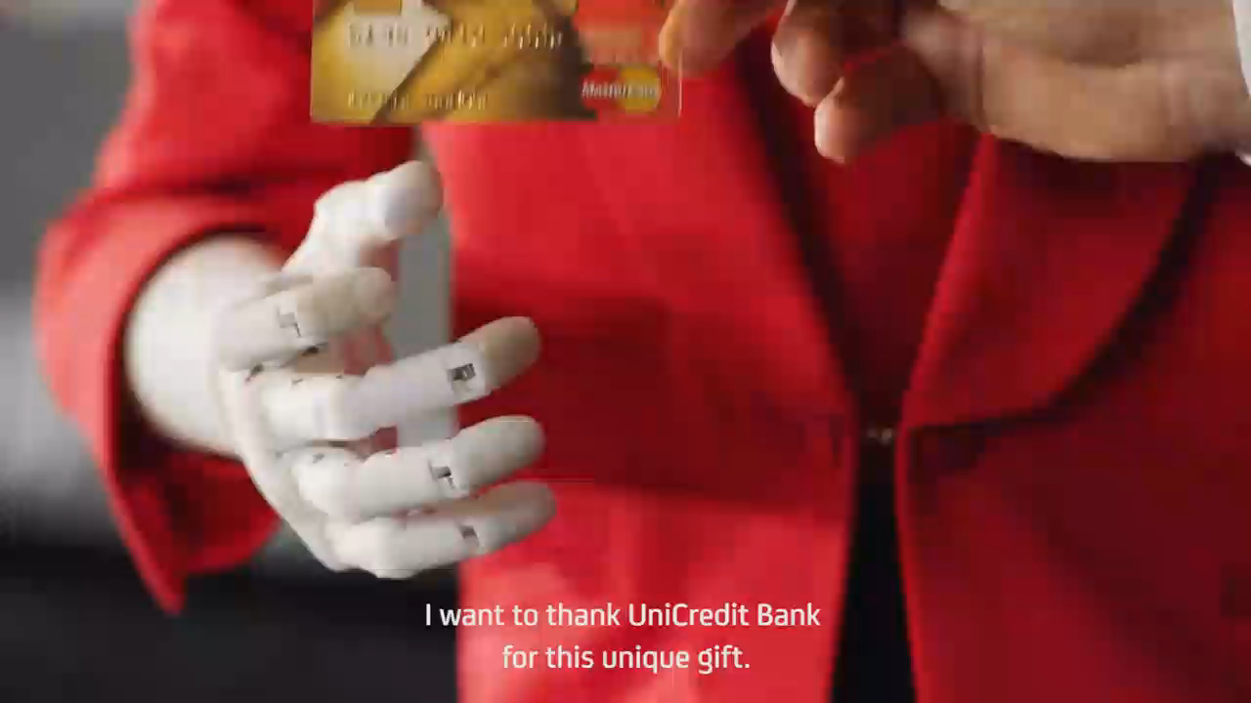

Slide 4
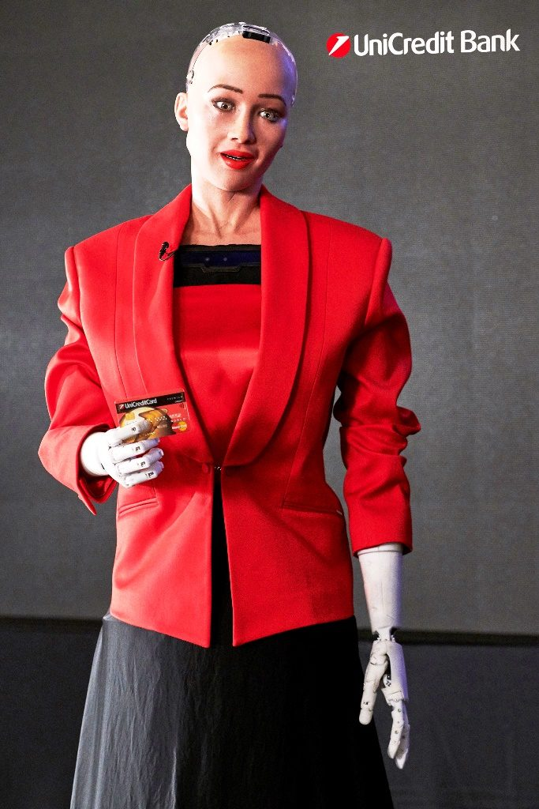
Banking on robots
Sophia is the first robot to receive citizenship of a country, an UN title and… a credit card
By the year 2025, robots and machines driven by AI are predicted to perform half of all productive functions in the workplace.

Slide 5
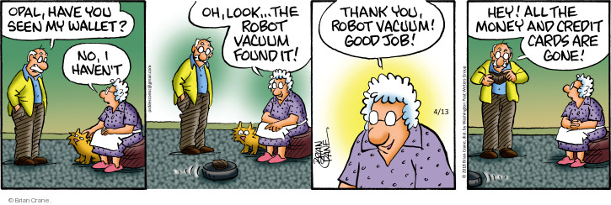

Slide 6
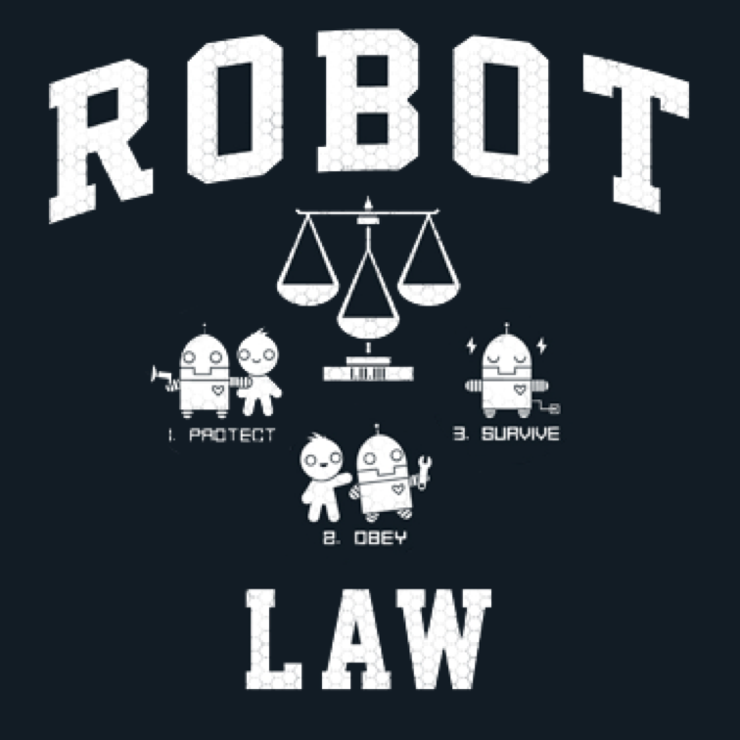
Ethical bits
Isaac Asimov introduced the first laws that regulate the conduct of robots
For now, however, we haven’t succeded in creating an AI smart enough to comprehend these laws

Slide 7
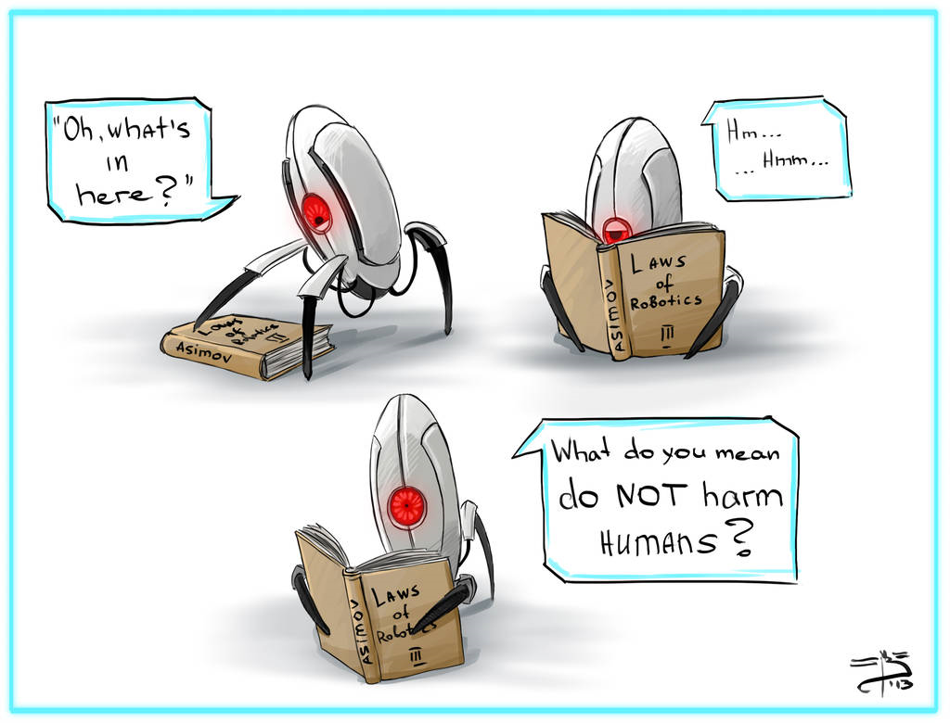

Slide 8
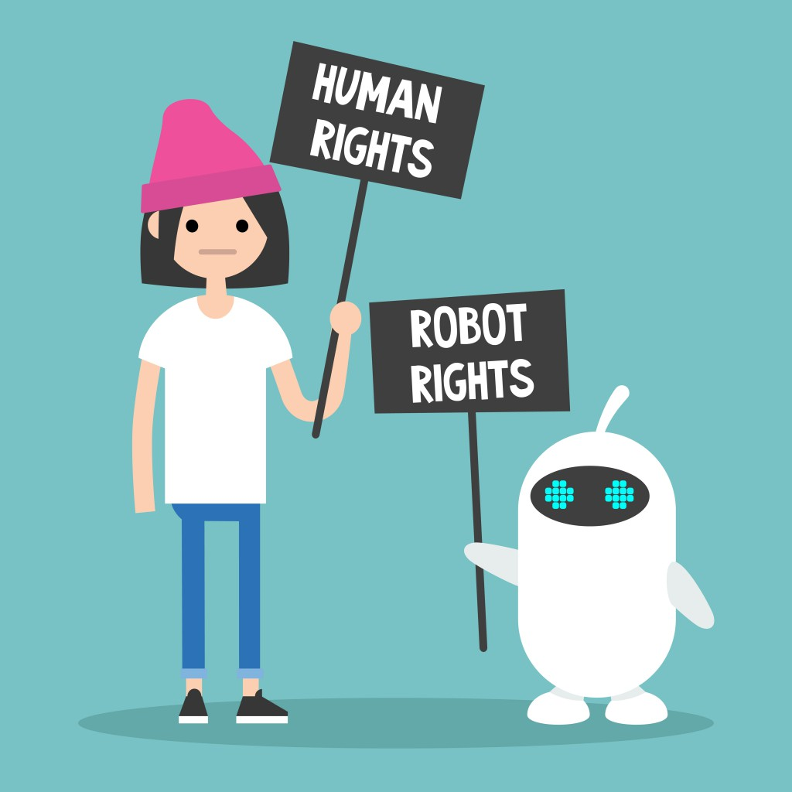
I declare you… robot and wife!
It is not clear if the robots will have any worker rights.
As robots have more advanced AI, empowering them to think and act like humans, legal standards need to change.

Slide 9
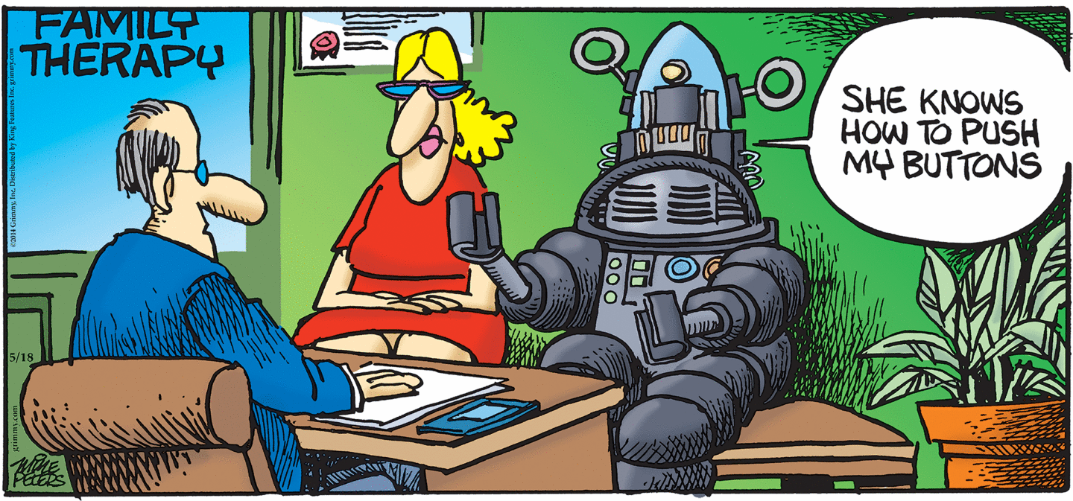

Slide 10
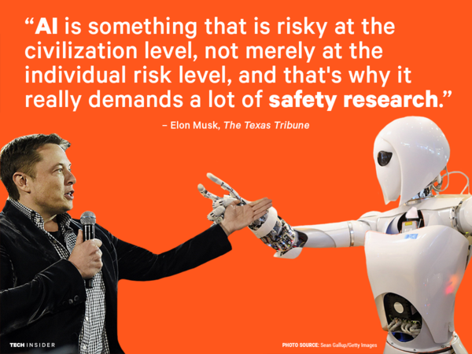

Slide 11
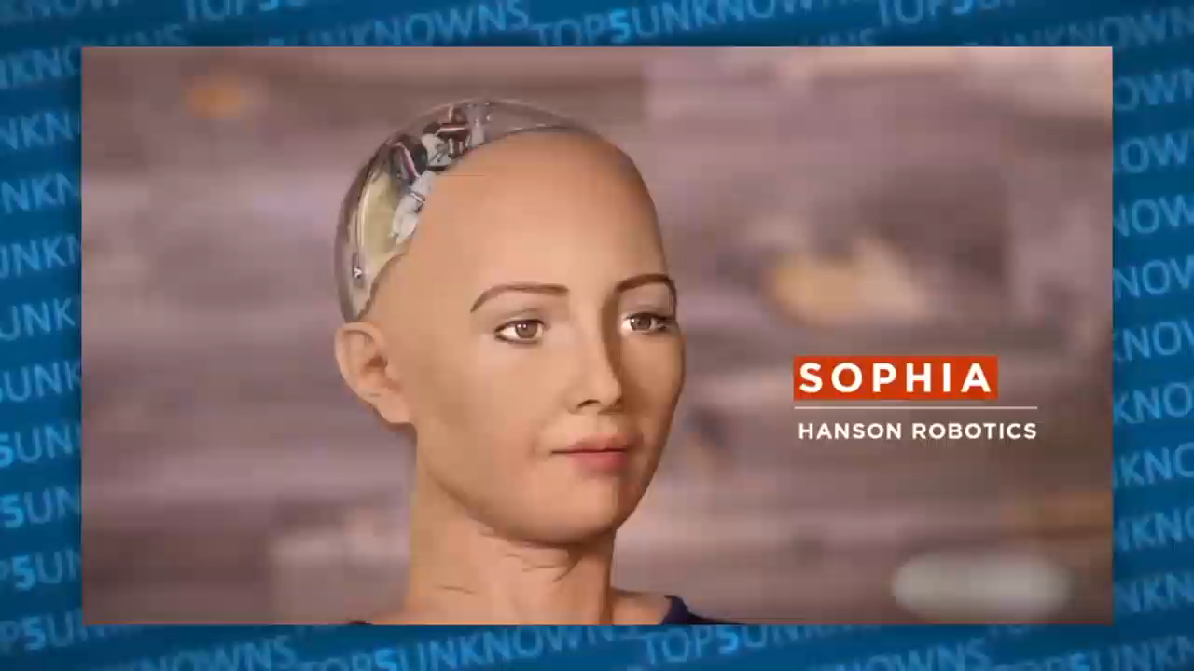



Slide 12
Bibliography
Asimov, I. – I, Robot
https://www.independent.co.uk/life-style/gadgets-and-tech/news/robots-civil-rights-android-artificial-intelligence-2045-destroy-humans-sophia-singularity-a8367331.html
http://news.bbc.co.uk/2/hi/technology/6425927.stm
https://www.asme.org/engineering-topics/articles/robotics/do-robots-deserve-legal-rights
https://www.cnbc.com/2018/12/27/now-is-the-time-to-figure-out-the-ethical-rights-of-robots-in-the-workplace-.html

